Slide 1
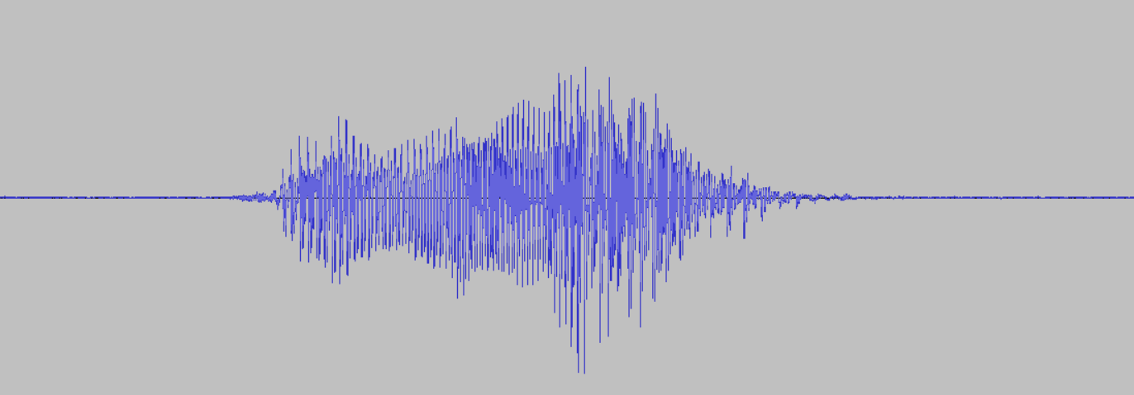


Slide 2


5333 samples
microphone
Compute MFCCs
MFCCs
(1 second of audio)
Inference
P_{_noise}
P_{_unknown}
P_{hello}
P_{stop}

Slide 3
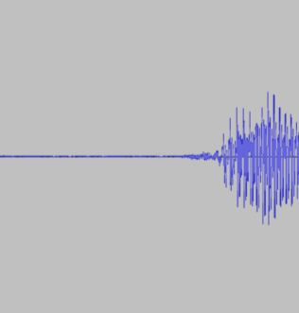

5333 samples
microphone
Compute MFCCs
MFCCs
(1 second of audio)
Inference
P_{_noise}
P_{_unknown}
P_{hello}
P_{stop}
MFCCs slide back
(dropping oldest chunk)

Slide 4
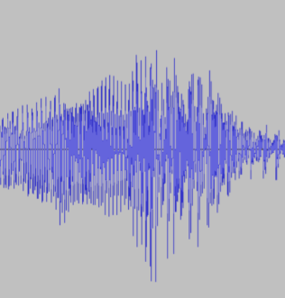

5333 samples
microphone
Compute MFCCs
MFCCs
(1 second of audio)
Inference
P_{_noise}
P_{_unknown}
P_{hello}
P_{stop}
MFCCs slide back
(dropping oldest chunk)

Slide 5
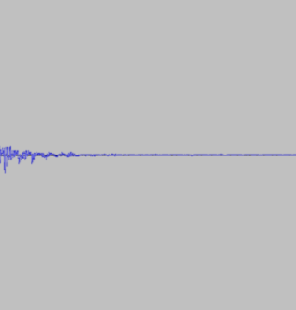

5333 samples
microphone
Compute MFCCs
MFCCs
(1 second of audio)
Inference
P_{_noise}
P_{_unknown}
P_{hello}
P_{stop}
MFCCs slide back
(dropping oldest chunk)

